Slide 1
Assignment
29-04-25
Presented by
S. Vinish

Slide 2
What is Heap Memory?
Definition: Heap memory in SAP refers to dynamically allocated memory that a work process can use outside the shared memory, especially when it enters private mode.
🔑 Key Points:
Heap memory is process-local: Only the allocating process (e.g., DIA work process) can access it.
It's used when shared memory (roll + extended memory) is exhausted.
Heap memory is also called private memory.
Heap memory is not released until the work process ends — unlike roll/extended memory, which is reusable.
Where it's configured:
abap/heap_area_dia (dialog)
abap/heap_area_nondia (for background, update, etc.)
abap/heap_area_total (total across all processes)

Slide 3
What is Roll-In and Roll-Out?
Definition:
Roll-in and roll-out are memory management techniques used to share work processes among users in SAP.
🔑 Key Points:
Operation | Description
Roll-In | When a user is assigned to a work process, the user context is loaded from roll memory/shared memory into the work process.
Roll-Out | After a task is completed, the user context is unloaded, and the work process is freed.
This allows resource sharing in SAP, enabling many users with few work processes.
Efficient use of shared memory: roll memory, extended memory.
Happens transparently during dialog steps.

Slide 4
Work Process Private Mode (Linked with Heap Memory)
Definition:
Private mode is when a work process cannot access shared memory anymore and switches to heap memory (private).
🔑 Key Points:
Triggered when a dialog step exceeds extended memory limit (em/initial_size_MB, ztta/roll_extension).
The process enters "Private Mode" and uses heap memory.
Heap memory is non-shared, so the process is no longer reusable — it stays assigned to the user until the task ends.
Can degrade system performance if too many processes enter private mode.
Check ST02 (Memory Overview) or SM50 (status: PRV) to monitor.

Slide 5
How Can You Use ST03 for Analysis?
ST03 (Workload Monitor) is used to analyze system performance, workload distribution, and identify bottlenecks.
🔑 Key Functions:
Area | Description
Workload Overview | See system usage over time: dialog, background, update, RFC, spool jobs, etc.
Transaction Profile | List of most used transactions (e.g., SE38, VA01), execution time, frequency.
User Profile | Shows which users consume the most resources.
Response Time Analysis | Breaks down response time into components: CPU, DB time, wait time, etc.
Work Process Usage | Check average load per work process type.
Memory Use | See memory per task: roll, extended, heap usage.

Slide 6
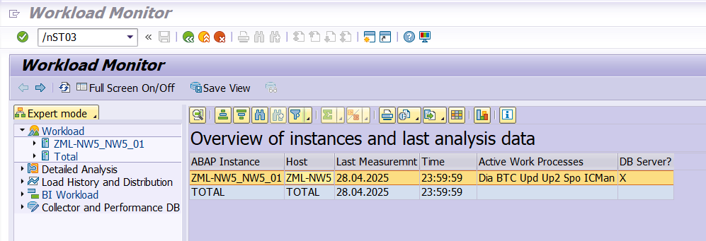
After entering into ST03

Slide 7
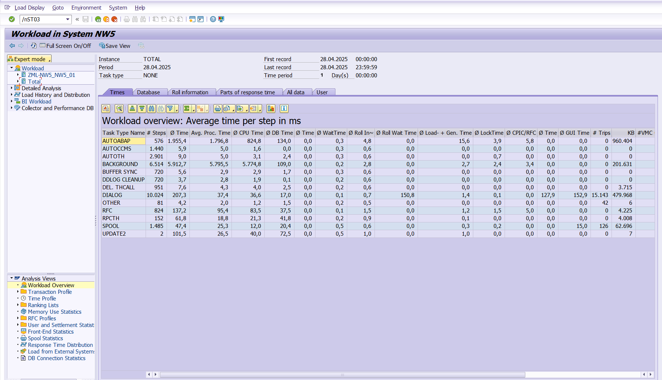
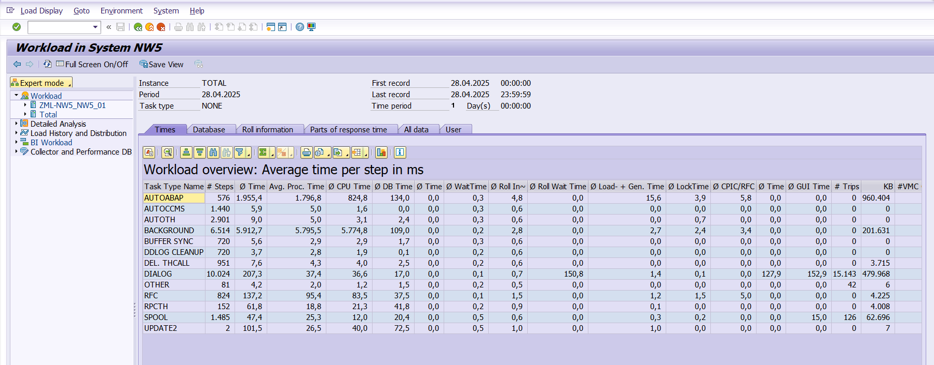
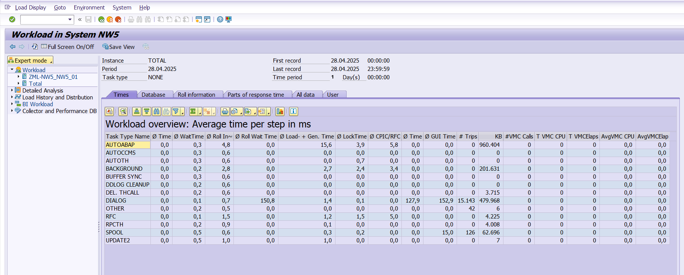
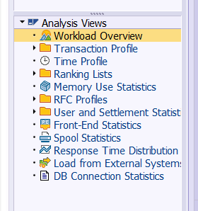

Slide 8
Thank You

